Slide 1
Noisy Image Classification
Shrivatsa Neerjake
Rebeca Tijiboy

Slide 2
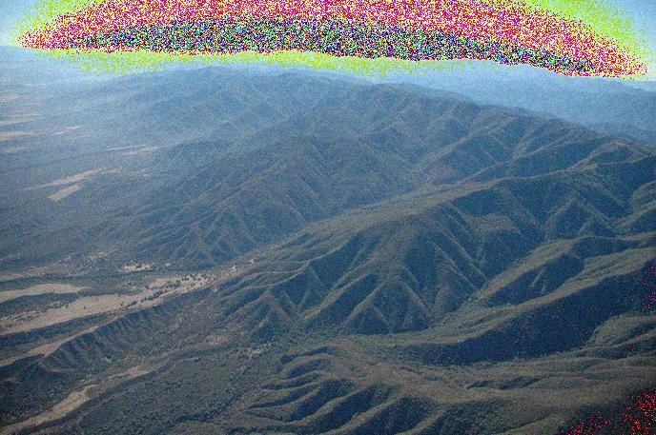
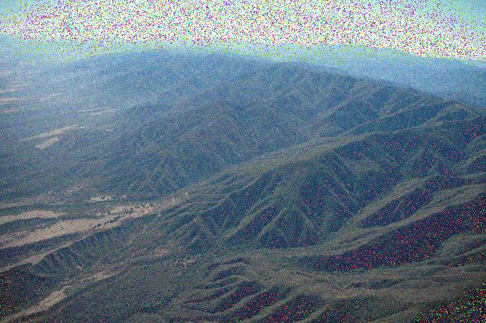
Data set-578 Aerial Images
289 With Sparse Noise
289 With Diffused Noise

Slide 3
Features
Image histogram standard deviation- global
Signal to noise ratio
Intensity
Area of objects
Visual salience
RMS contrast

Slide 4
Bayes Classifier
Training Set: 498 images (249 per class)
Two Classes: Diffused and Sparse Noise
Test Set: 80 images (40 per class)
Four features

Slide 5
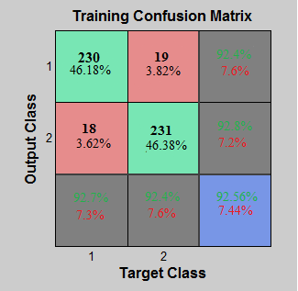
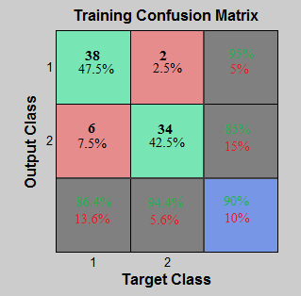
Confusion Matrices

Slide 6
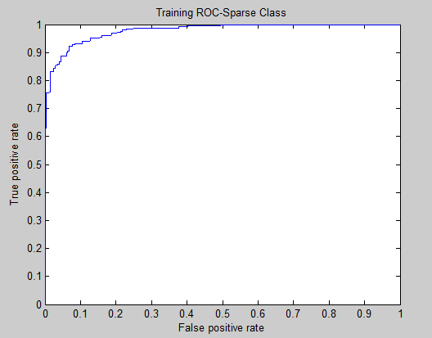
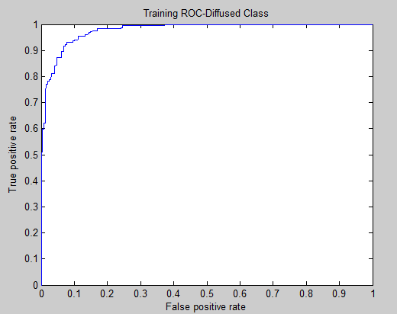
ROC Curves

Slide 7
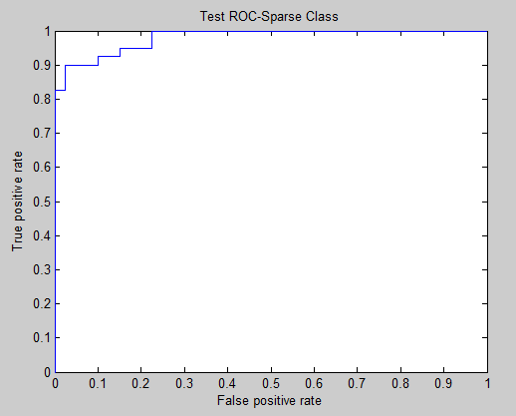
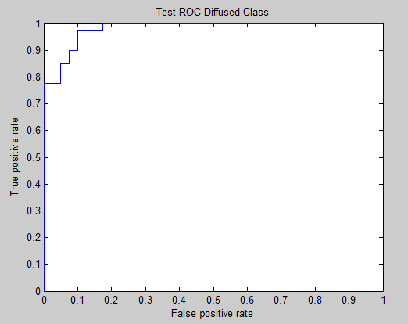

Slide 8
Neural Network
Training Set: 392 images (188-class1, 204-class2 )
Two Classes: Diffused and Sparse Noise
Test Set: 81 images (40-class1, 41** )
Four features
20 Neurons

Slide 9
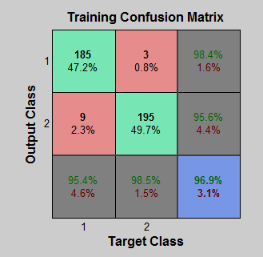
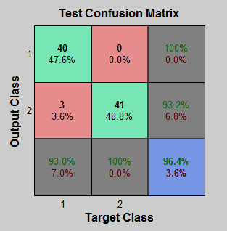
Neural Networks- Confusion Matrices

Slide 10
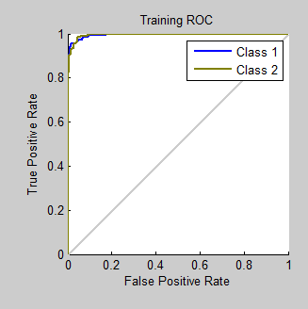
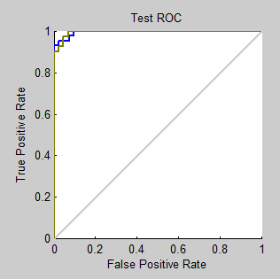
ROC Curves

Slide 11
Results
Bayes Classifier
Percent Correct: 90%
Specificity: 85%
Sensitivity: 95%
Neural Network
Percent Correct: 96.4%
Specificity: 93.2%
Sensitivity: 100%

